Slide 1
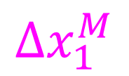
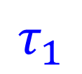

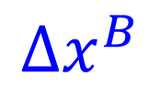
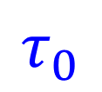
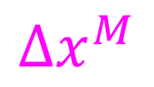
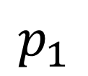
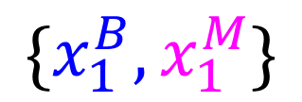
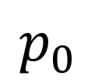
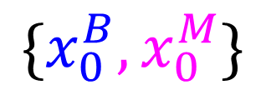
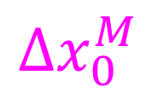
$$Δx_{0}^{M}$$
$$\{x_{0}^{B},x_{0}^{M}\}$$
$$τ_{0}$$
$$p_{0}$$
$$Δx^{B}$$
$$Δs^{MB}$$
$$p_{1}$$
$$τ_{1}$$
$${\{x_{1}^{B},x}_{1}^{M}\}$$
$$Δx^{M}$$
$$Δx_{1}^{M}$$

